Slide 1

Mechanical Properties of Materials
Dr. J. Venkatramani
219-B
venkatramani@iiitdm.ac.in

Slide 2
Mechanical Properties of Materials
Important mechanical properties in today’s structural applications
Strength
Hardness
Ductility
Stiffness
Types of loads:
Static
Dynamic – Impact, variable loading, deformation at constant load (creep)
A material may show different response to different kinds of forces such as compressive, tensile and shear of same magnitude can be different (e.g., wood).

Slide 3
Mechanical Properties of Materials
Certain Standards have to be following to do Laboratory testing to determine the mechanical properties.
American Society for Testing and Materials (ASTM – http://www.astm.org).
A structural engineer’s role is to determine the stress distribution and deflections in the component/member that is being designed. These aspects will be discussed in a detailed course “Mechanics of Materials”.
Materials and Metallurgical engineers are concerned with producing and fabricating materials to suit a particular application.

Slide 4
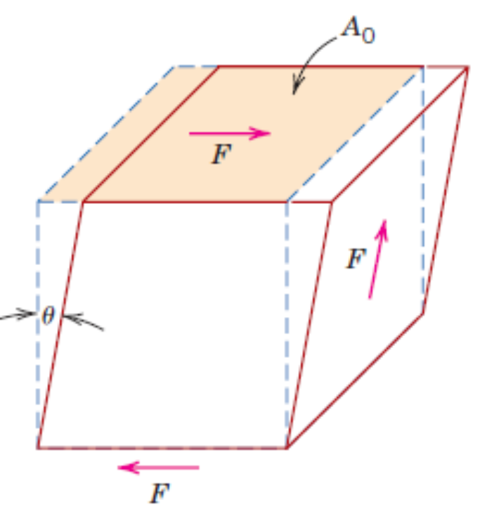
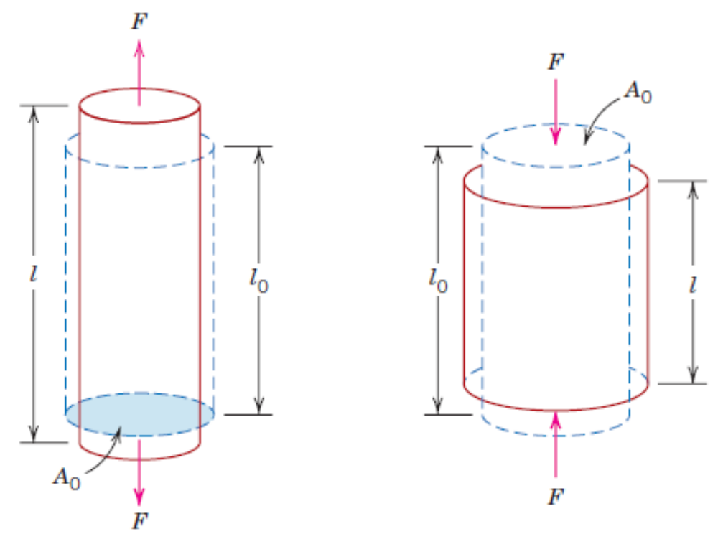
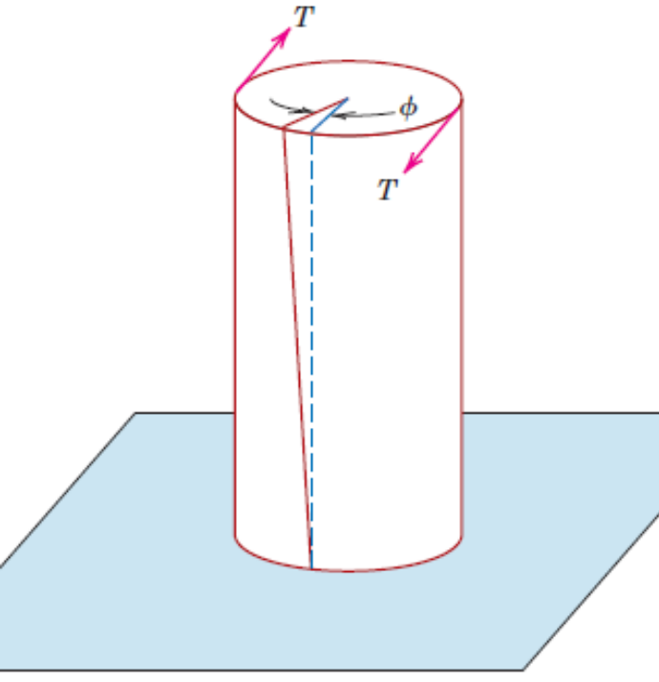
Concept of Stress
Stress is the resistance force acting per unit area, the direction of the resistance force and the direction of the normal to the area being arbitrary.
Shear stress due to a shear force
Compressive normal stress
Tensile normal stress
Shear stress due to a torque

Slide 5
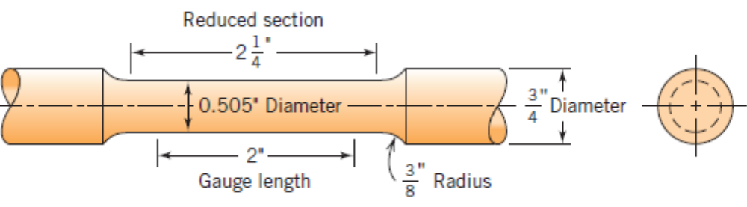
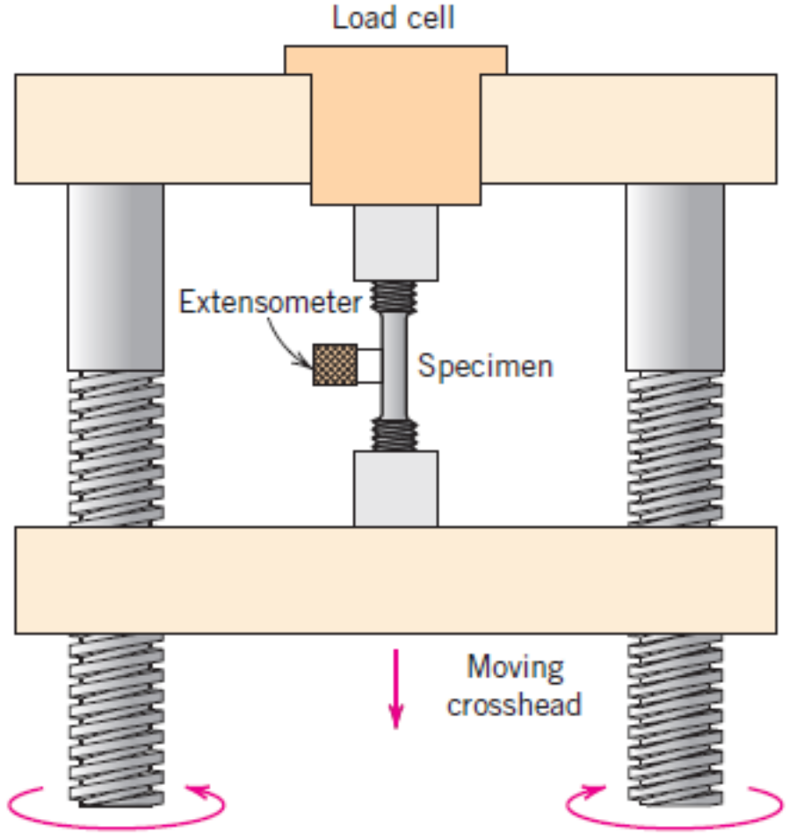
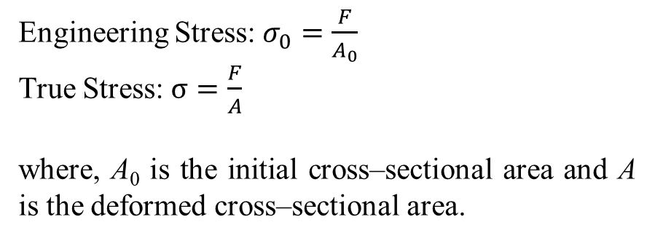
Concept of Stress
Tensile Testing Specimen (Dog – Bone Specimen)
Engineering Stress: $σ_{0}=\frac{F}{A_{0}}$
True Stress: $σ=\frac{F}{A}$
where, A₀ is the initial cross–sectional area and A is the deformed cross–sectional area.

Slide 6
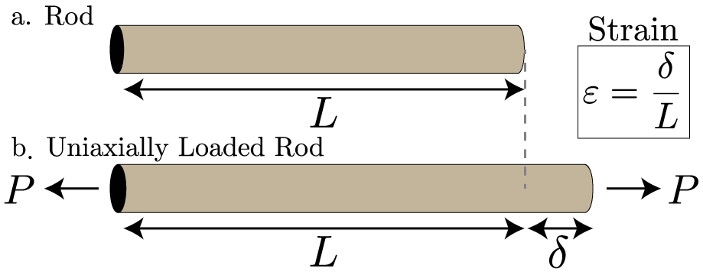
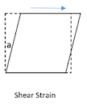
Concepts of Strain
Engineering Normal Strain: Ratio of change in length to original length of a linear element taken along a certain direction. Indicates stretch. Compressive strains imply decrease in the length, while tensile strain implies increase in the length, along the direction being considered.
Engineering Shear Strain: Change in angle between two linear elements whose directions are initially perpendicular. Indicates distortion.
Strain Energy: Energy stored by the material as it is subjected to deformation.

Slide 7
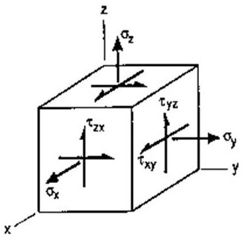
Concept of 3–D State of Stress
State of Stress at a point

Slide 8
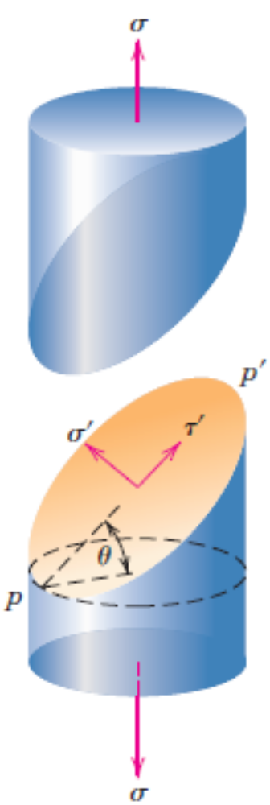
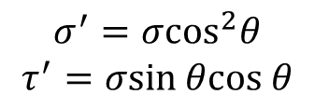
Concept of 3–D State of Stress: Stress components
$$σ^{′}=σ\cos^{2}θ$$
$$τ^{′}=σsin θcos θ$$

Slide 9


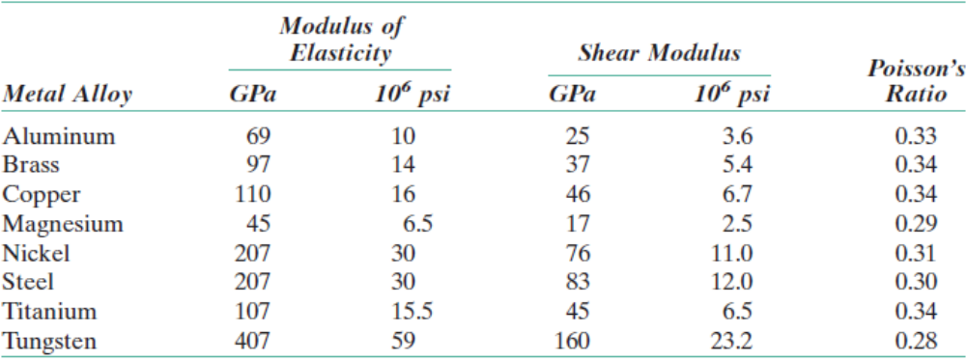
Stress – Strain Behaviour
Most of the metals exhibit linear relationship between stress and strain up to a certain limit of stress. This is known as Hooke’s law.

Slide 10
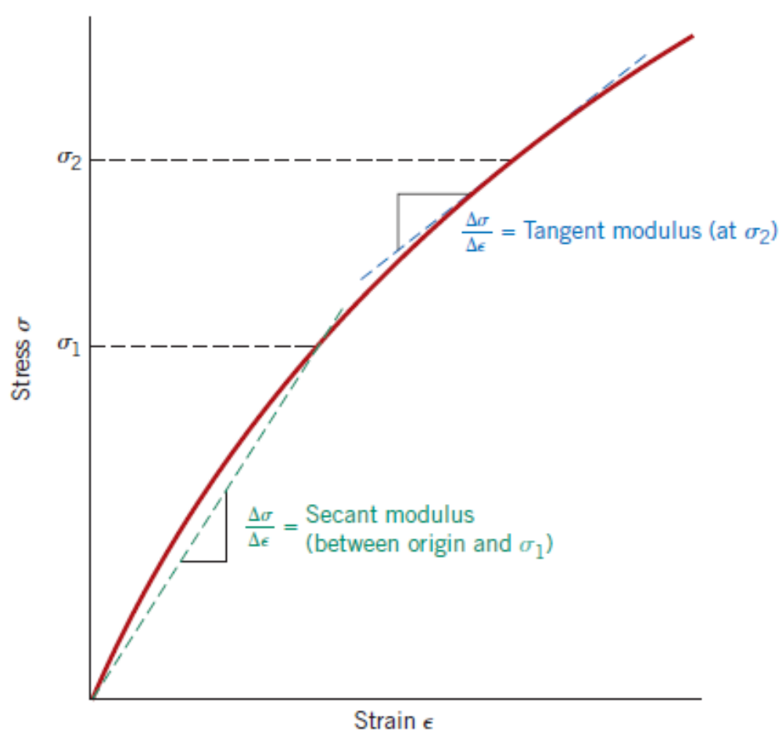
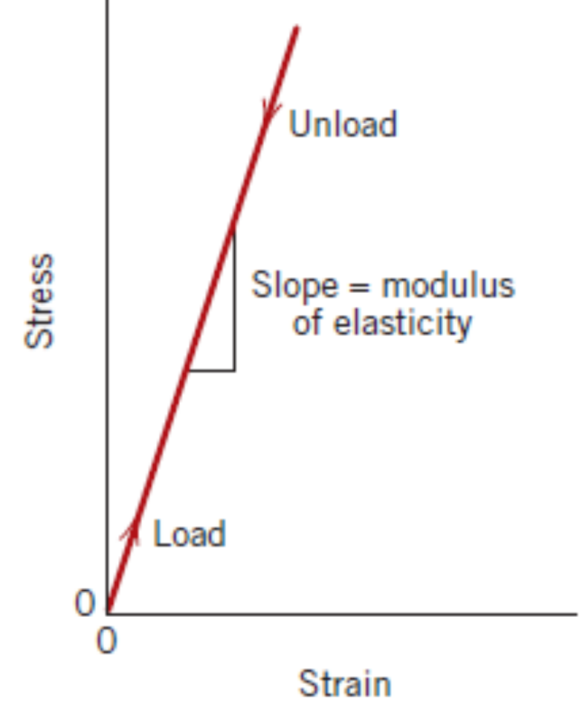
Stress – Strain Behaviour
Most of the metals exhibit linear relationship between stress and strain up to a certain limit of stress. This is known as Hooke’s law.
Certain materials like Grey cast iron, concrete and polymers exhibit nonlinear elasticity.

Slide 11
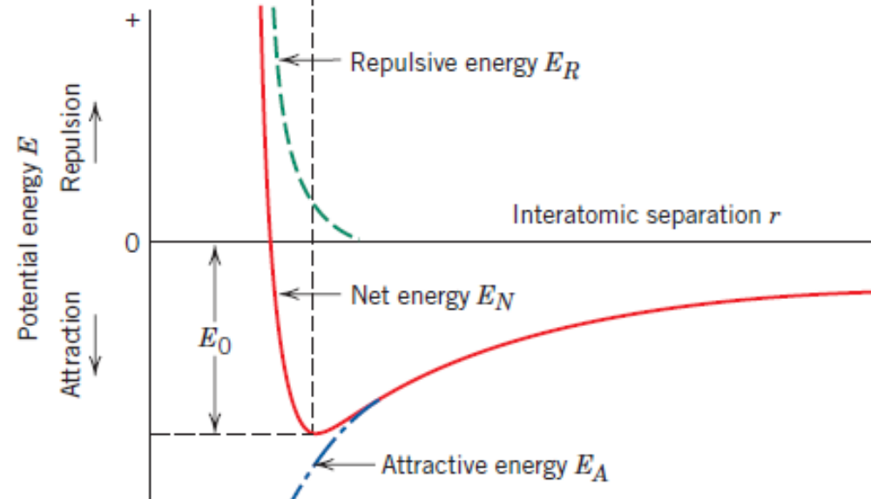
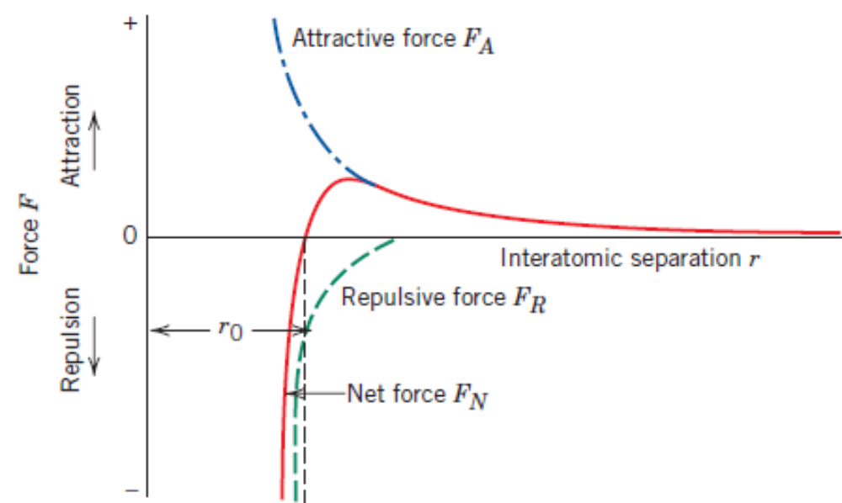
Viewing Elasticity at atomistic length scales
Energy potential as a function of the distance between a pair of atoms
Force between a pair of atoms

Slide 12
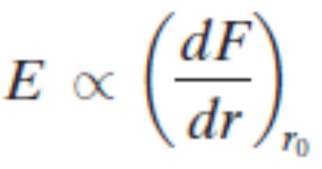
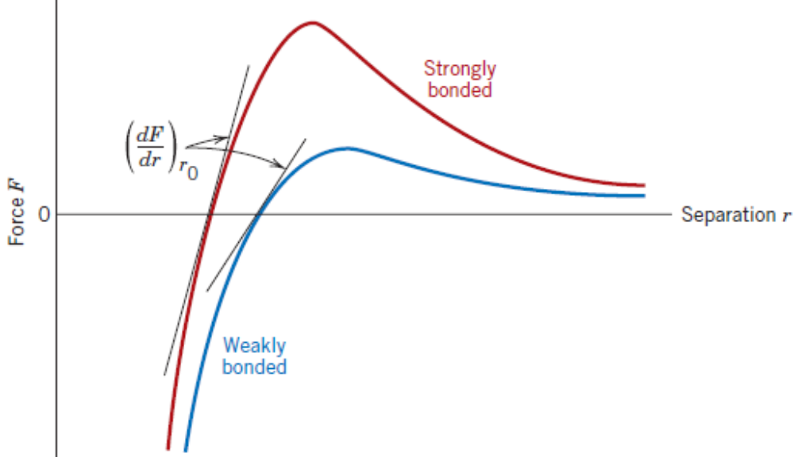
Viewing Elasticity at atomistic length scales

Slide 13
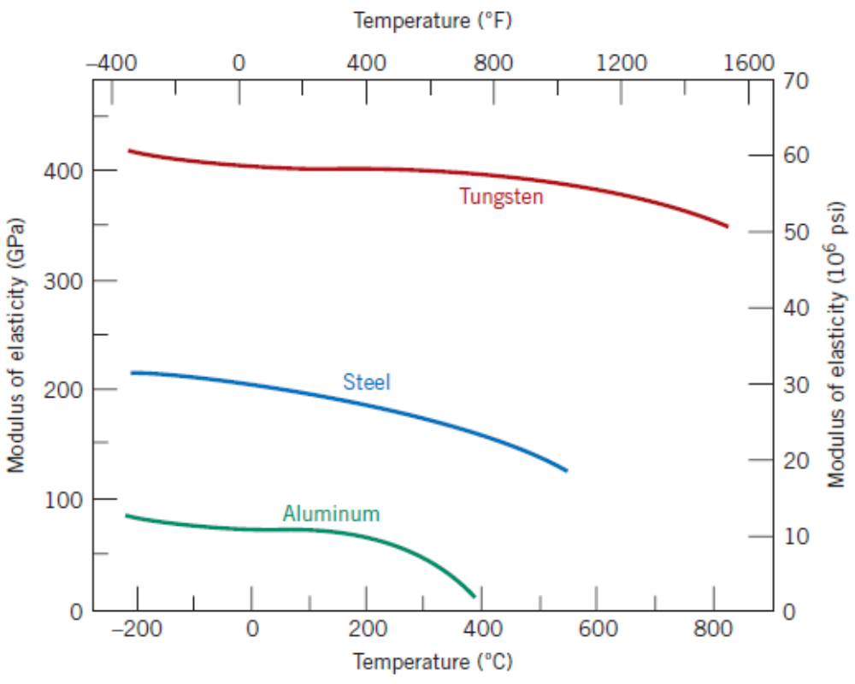
Elastic Modulus Vs Temperature Rise

Slide 14
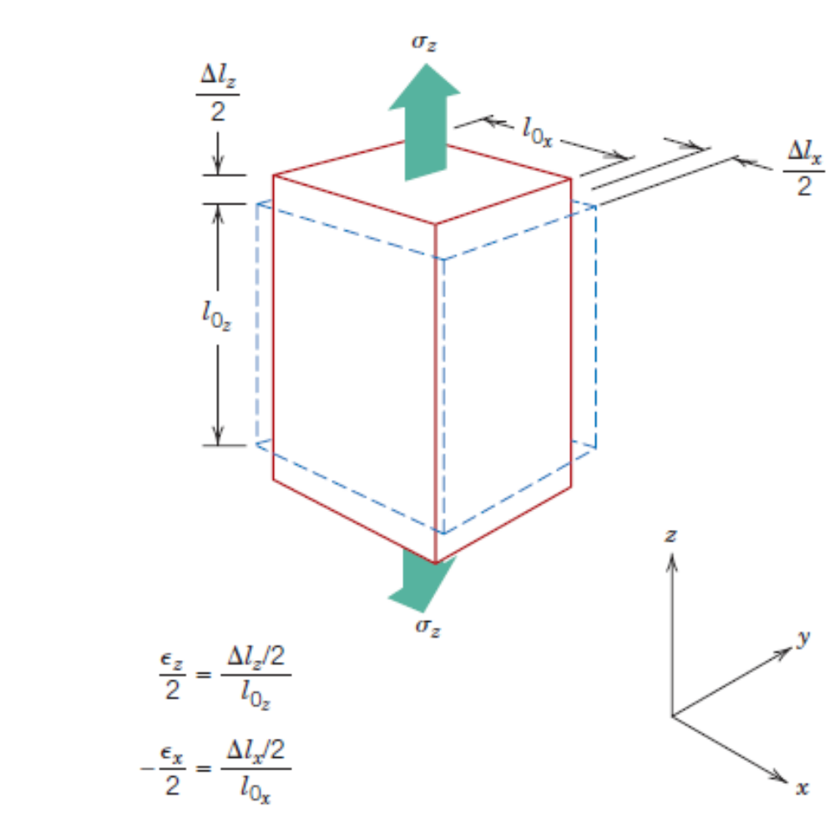
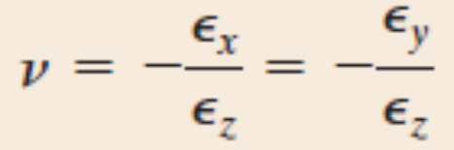
Elastic Properties of Materials
Poisson’s ratio (ν): Ratio of lateral strain to longitudinal strain, with a negative sign as in the equation below. The negative sign is to ensure that the value of ν remains positive.

Slide 15
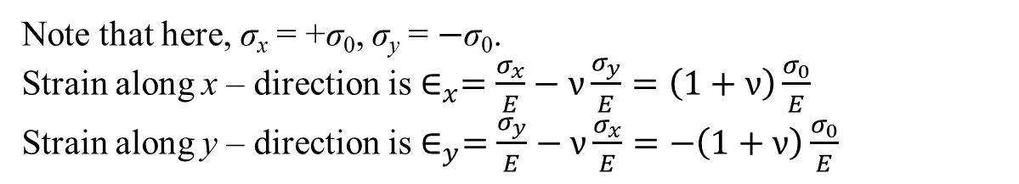
Bi – axial State and relation between Elastic Constants In Isotropic Materials
σ₀
Poisson’s ratio (ν): Ratio of lateral strain to longitudinal strain, with a negative sign as in the equation below. The negative sign is to ensure that the value of ν remains positive.
D
C
y
σ₀
σ₀
A
B
σ₀
x
Note that here, σ_{x} = +σ₀, σ_{y} = $−$σ₀.
Strain along x – direction is $∈_{x}=\frac{σ_{x}}{E}−ν\frac{σ_{y}}{E}=\left(1+ν\right)\frac{σ_{0}}{E}$
Strain along y – direction is $∈_{y}=\frac{σ_{y}}{E}−ν\frac{σ_{x}}{E}=−\left(1+ν\right)\frac{σ_{0}}{E}$

Slide 16
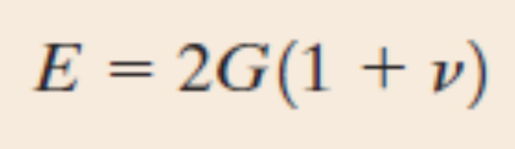
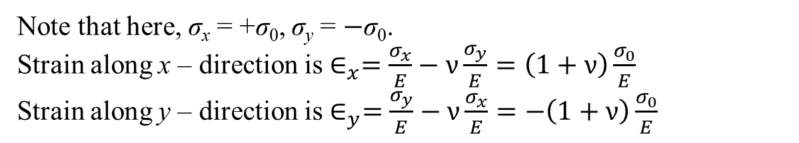
Bi – axial State and relation between Elastic Constants In Isotropic Materials
Note that here, σ_{x} = +σ₀, σ_{y} = $−$σ₀.
Strain along x – direction is $∈_{x}=\frac{σ_{x}}{E}−ν\frac{σ_{y}}{E}=\left(1+ν\right)\frac{σ_{0}}{E}$
Strain along y – direction is $∈_{y}=\frac{σ_{y}}{E}−ν\frac{σ_{x}}{E}=−\left(1+ν\right)\frac{σ_{0}}{E}$
σ₀
D
S
C
y
P
R
σ₀
σ₀
σ_{x’} = ?, σ_{y’} = $?$, τ_{x’y’} = ?, τ_{y’x’} = ?
A
Q
B
σ₀
x
y’
σ_{y'}
τ_{y‘x'}
S
R
σ_{x'}
τ_{x'y'}
σ_{x'}
τ_{x'y'}
P
Q
τ_{y‘x'}
σ_{y'}
x’

Slide 17
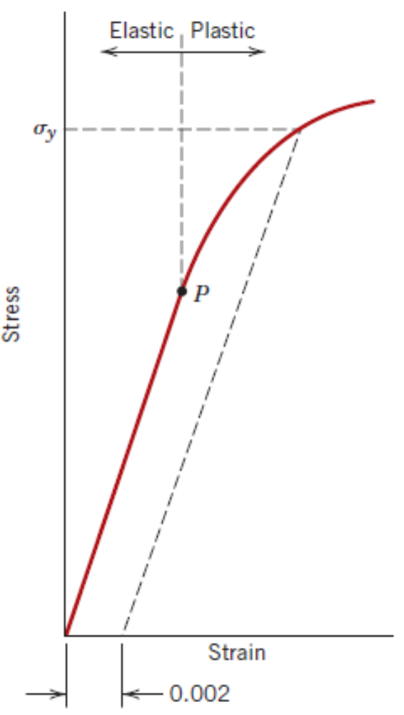
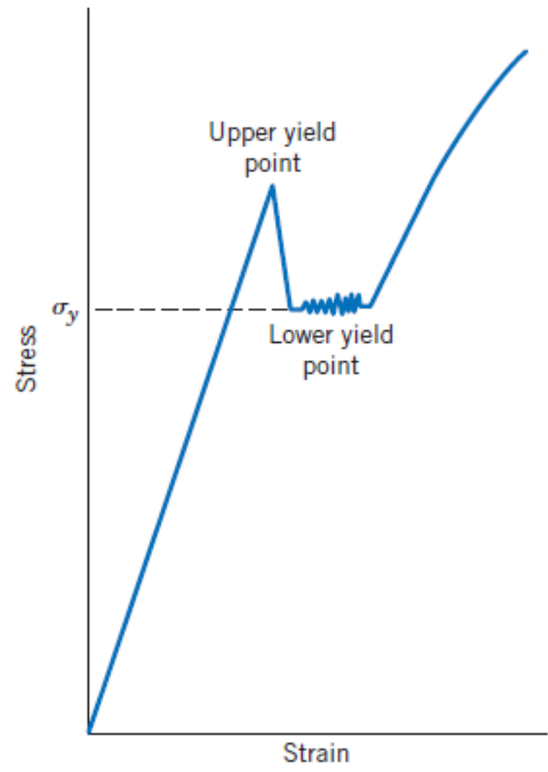
Plastic Deformation – Uniaxial Tension Test
Yielding
Yield strength
Large scale atomic displacements by breaking and reforming of atomic bonds
Typical stress–strain curves for non–ferrous alloys
Typical stress–strain curves for ferrous alloys

Slide 18
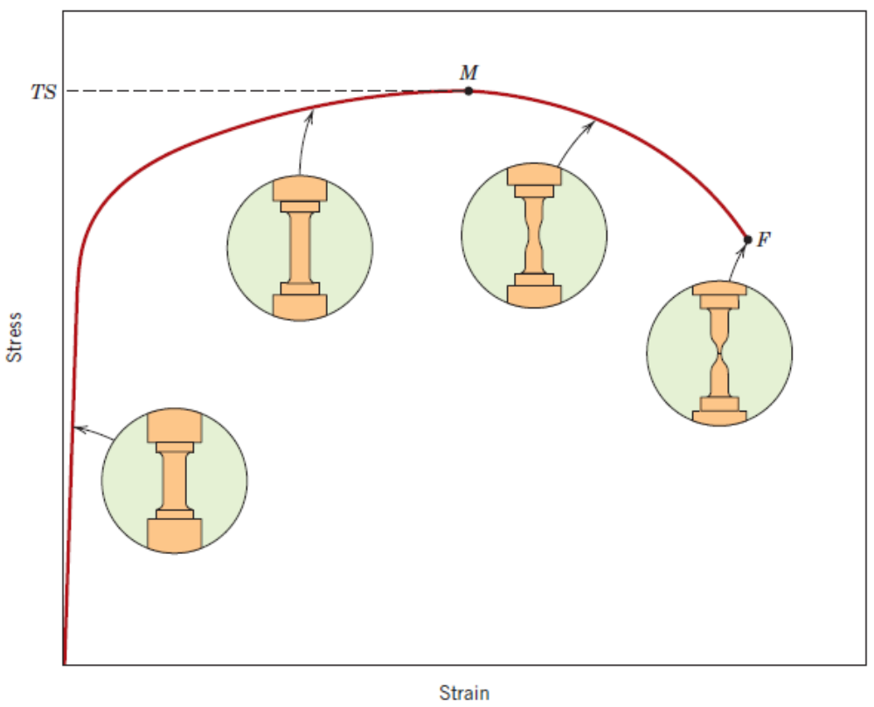
Plastic Deformation – Uniaxial Tension Test
Tensile Strength: The point M in the adjacent stress–strain curve.

Slide 19
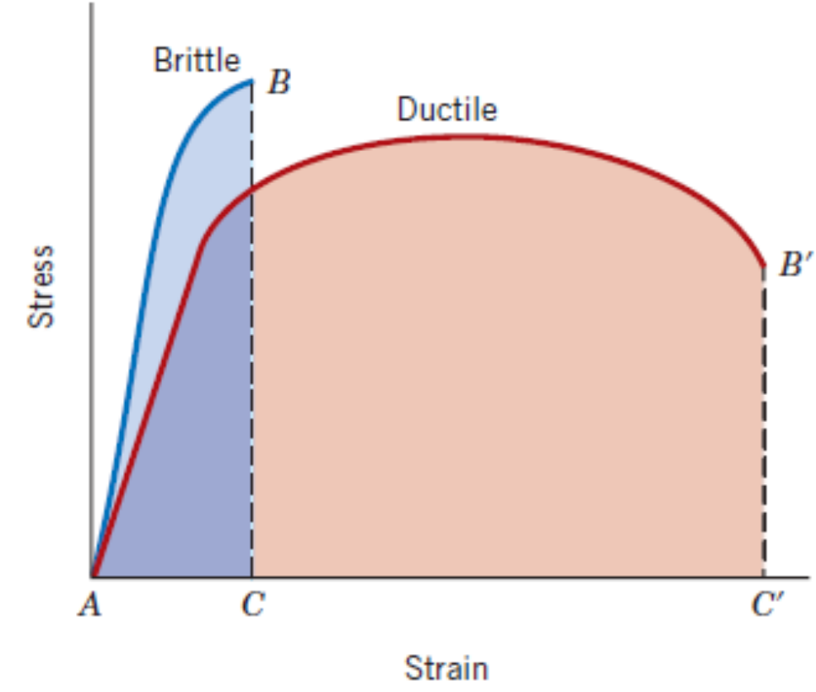
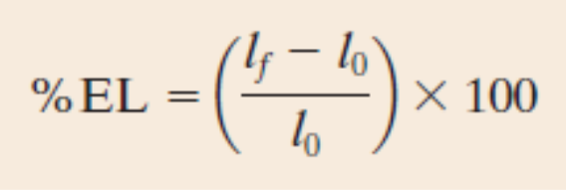
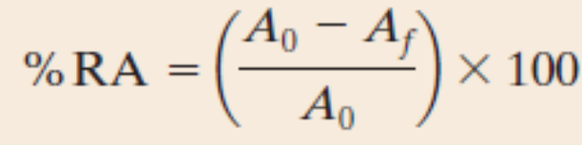
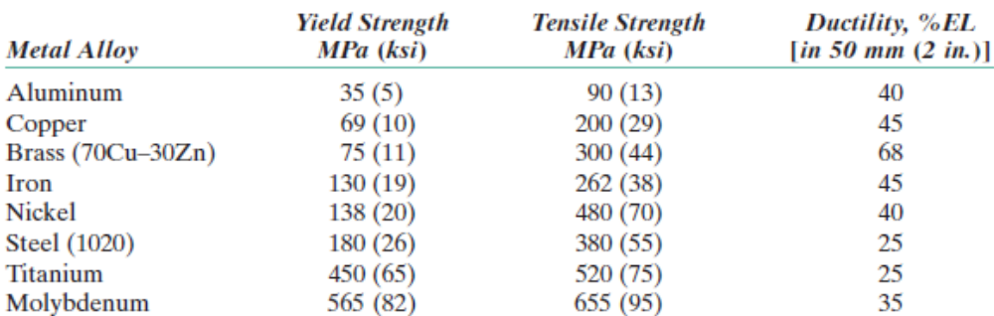
Plastic Deformation – Uniaxial Tension Test
Ductility
Quantified as % elongation of length, or, % reduction in area

Slide 20
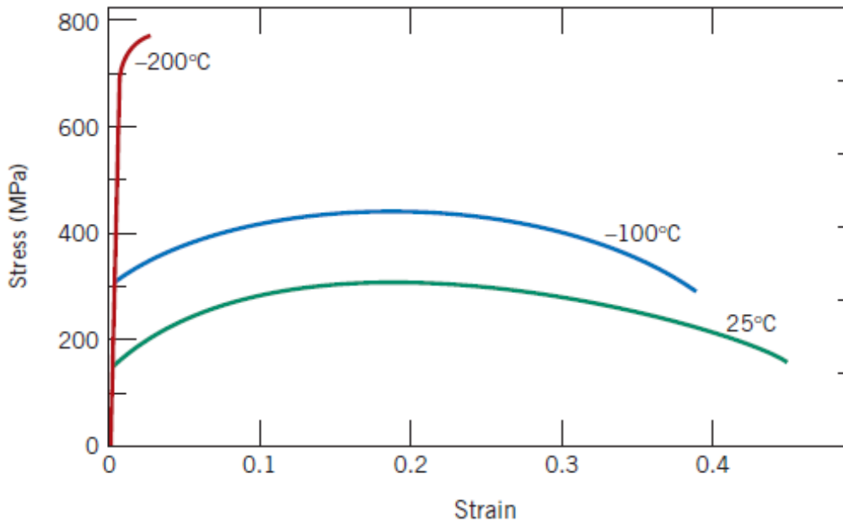
Plastic Deformation – Uniaxial Tension Test
Ductility
Quantified as % elongation of length, or, % reduction in area

Slide 21
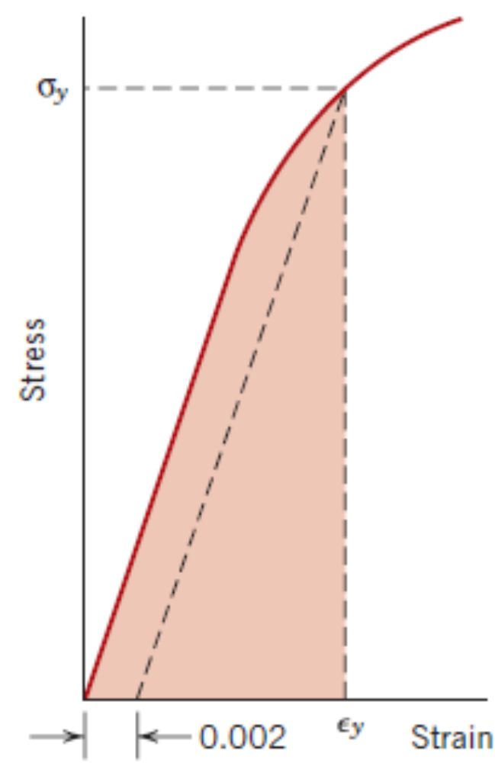
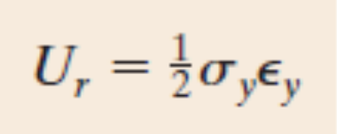
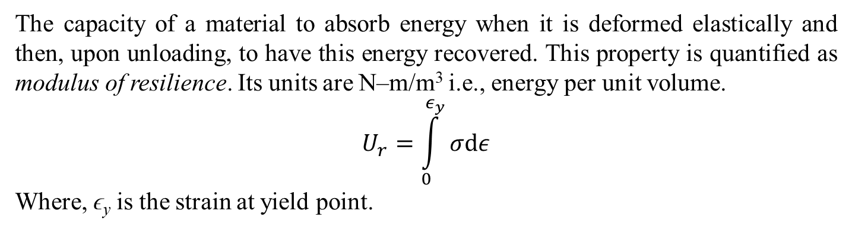
Plastic Deformation – Uniaxial Tension Test
Resilience
The capacity of a material to absorb energy when it is deformed elastically and then, upon unloading, to have this energy recovered. This property is quantified as modulus of resilience. Its units are N–m/m³ i.e., energy per unit volume.
$$U_{r}=\int_{0}^{ε_{y}}{σdε}$$
Where, ϵ_{y} is the strain at yield point.

Slide 22
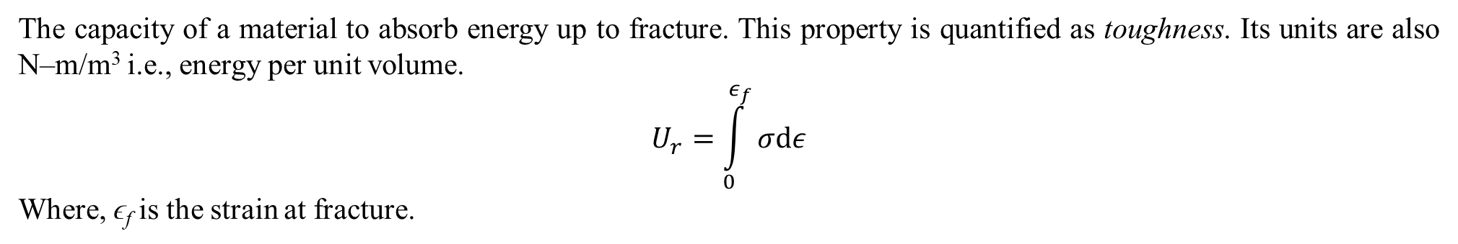
Plastic Deformation – Uniaxial Tension Test
Toughness
The capacity of a material to absorb energy up to fracture. This property is quantified as toughness. Its units are also N–m/m³ i.e., energy per unit volume.
$$U_{r}=\int_{0}^{ε_{f}}{σdε}$$
Where, ϵ_{f} is the strain at fracture.

Slide 23
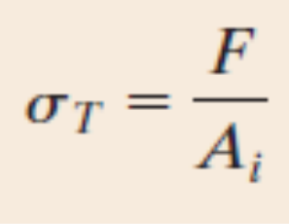
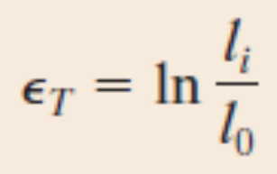
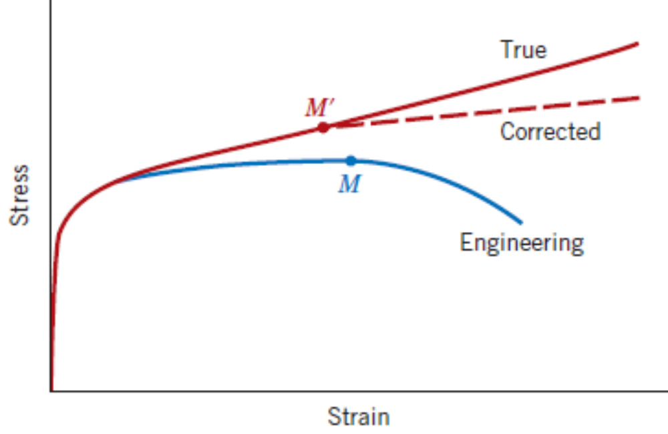

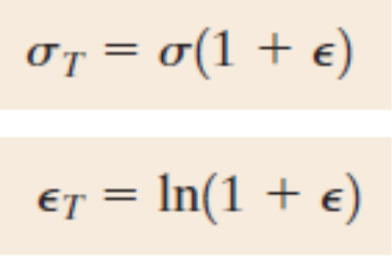
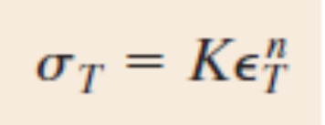
Plastic Deformation – Uniaxial Tension Test
True Stress – True Strain
Assuming no change in volume during the entire deformation process
The true stress–true strain relationship from the onset of plastic deformation to necking can be described using

Slide 24
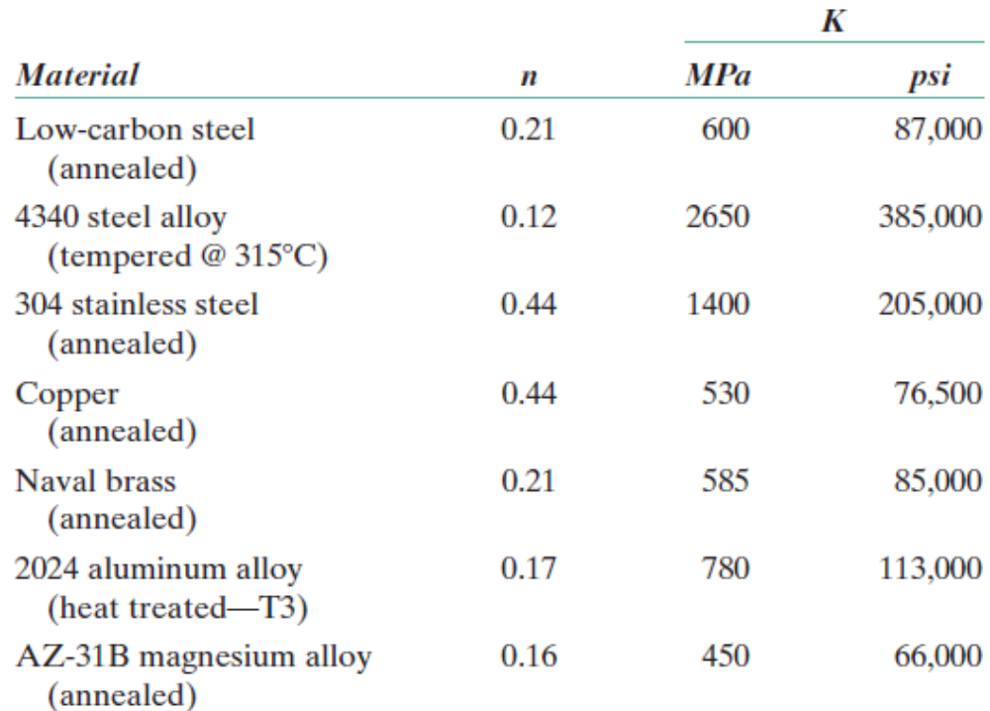
Plastic Deformation – Uniaxial Tension Test
True Stress – True Strain
The true stress–true strain relationship from the onset of plastic deformation to necking can be described using

Slide 25
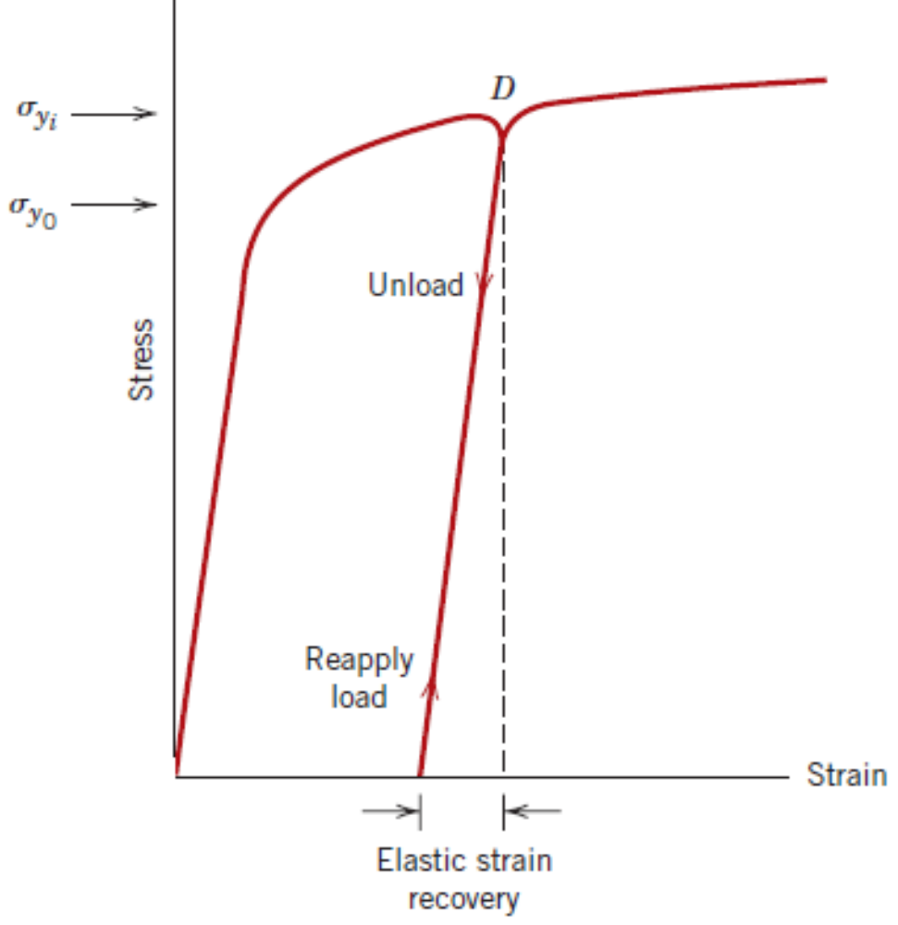
Plastic Deformation – Uniaxial Tension Test
Elastic Strain Recovery After Certain Amount of Plastic Deformation
The unloading path is parallel to the initial elastic loading.
The slope of this unloading path is same as the Elastic modulus.
Thus, one can compute the elastic recovery strain. Then, whatever is left out is the permanent strain or residual strain.

Slide 26
Hardness
Hardness is another important material property which plays significant role in applications involving hard contacts.
Earliest hardness tests – Mohs scale ranging from 1 for talc to 10 for diamond.
Later on, quantitative tests were developed where a small indenter is forced into the surface of the material to be tested. The depth of penetration of the indenter and the load applied is related to a hardness number.
For a given load, if the depth of penetration is higher, lower would be the hardness number of the material and softer would be its surface.
Types of hardness test:
  Rockwell test
  Brinell test
  Vickers Microhardness test
  Knoop Microhardness test

Slide 27
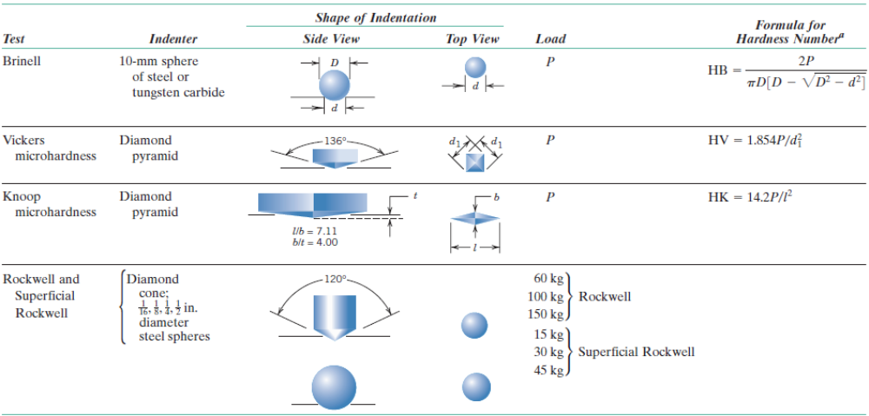
Hardness

Slide 28
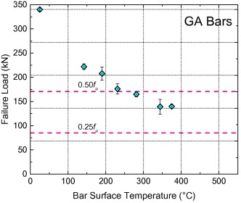
To account for variations in determination of properties
No two material sources are same. No two operators making the specimens have same skills.
No two test setups give same kind of measurements. No two operators can record same measurements. Thus, variations are inherent in determination of material properties and they are uncontrollable.
Normally, the method of reporting material properties involve mentioning mean and the deviation (error) as shown in the adjacent picture.

Slide 29
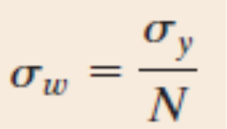
To account for uncertainty in calculation of applied loads
Determination of applied loads and the computation of induced stresses also have uncertainties.
Therefore, a certain amount of allowance needs to be considered during design.
For example, a connecting rod is required to be designed such that it does not undergo any plastic deformation at all. For this, the stress levels within the connecting rod must be below the yield strength of the material σ_{y}. Instead of using this value, a reduced stress threshold is used while designing the connecting rod.
N is called the factor of safety, usually taken in the range of 1.2 to 4.0.

Slide 30
Practice Problems
A piece of copper originally 300 mm long is pulled in tension with a stress of 275 MPa. If the deformation is entirely elastic, what will be the resultant elongation? The elastic modulus of Copper is 110 GPa.
A tensile stress is to be applied along the long axis of a cylindrical brass rod that has a diameter of 10 mm. Determine the magnitude of the load required to produce a 2.5 X 10^{–3} mm change in diameter if the deformation is entirely elastic. The elastic modulus of Brass is 97 GPa and Poisson’s ratio is 0.34.
A cylindrical specimen of steel having an original diameter of 12.8 mm is tensile tested to fracture and found to have an engineering fracture strength of 460 MPa. If its cross-sectional diameter at fracture is 10.7 mm, determine (a) the ductility in terms of percent reduction in area (b) the true stress at fracture.
Compute the strain-hardening exponent n for an alloy in which a true stress of 415 MPa produces a true strain of 0.10, assuming a value of 1035 MPa for K.
A tensile-testing apparatus is to be constructed that must withstand a maximum load of 220,000 N. The design calls for two cylindrical support posts, each of which is to support half of the maximum load. Furthermore, plain-carbon (1045) steel ground and polished shafting rounds are to be used; the minimum yield and tensile strengths of this alloy are 310 MPa and 565 MPa, respectively. Specify a suitable diameter for these support posts. Use a factor of safety N = 5.

